Slide 1

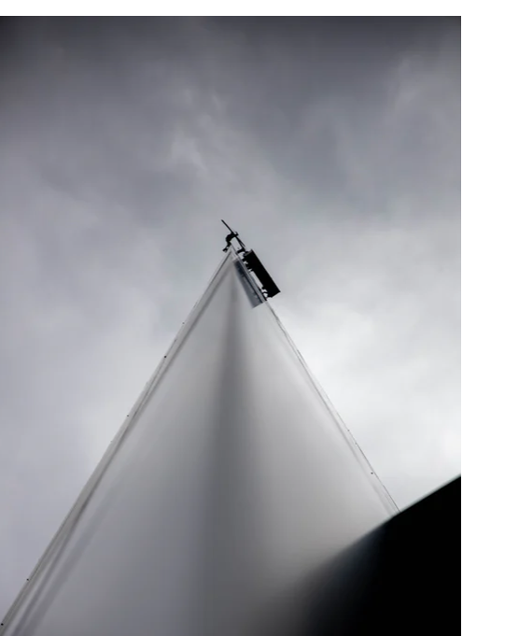
Stories of Covid-19:
Social Pasts & Futures in CityLife
Erica Masserano
Sam Dodd

Slide 2
The Pandemic & Us
Elders in the pandemic are in an impossible position
Isolation lowers health risks, but heightens mental health risks, which heightens health risks
Social exclusion is another important risk factor
From our 2021 article The Sociological Observer, Issue 3, pages 118-123
https://sociology.ie/publication/the-sociological-observer/

Slide 3
CityLife:
Stories for
Change
PUBLIC ENGAGEMENT
INTERGENERATIONAL BONDING
CREATIVE PRACTICE
COLLABORATIVE, THERAPEUTIC
RESEARCH
LIFE WRITING AS CULTURAL HISTORY
Notes:
Unheard voices – the narratives we hear are mainstream, we are interested in the others – the bulk. Intergenerational – connecting people across generations to inspire and learn from each other.
Creativity as connection – creating doesn’t have to be a solitary pursuit, it can be a collaborative community one too, that brings people together.
Life Writing as Cultural History – this is not just creating a nice thing. It is adding to the cultural history of a place and bringing in all voices to the historical record. Our first print publication EastLife is held by two local history archives and the London Metropolitan Archives.
Intimacy – encouraging reconnection after a long period of apartness during the pandemic. Access - community elders are not only key sources of memories and cultural histories they are often isolated -- in terms of access, mobility, and technology -- from participation in cultural exchange.

Slide 4
Why?
For us: To make connections in an urban context and foster community cohesion by forging bonds between people from groups who may not usually interact
For community storytellers: to bridge the disconnectedness often associated with city life and to give a platform for ethical representation of marginalised groups
For young writers and academics: an opportunity to practice, publish and research
For knowledge: To engage with the multifaceted experience of life in cities through the ethical creation of literary works
For cities: To add more voices to the conversation about cities in a period of great change

Slide 5
In-Person Methodology
Participants are invited to workshops in which the community storytellers have unstructured life story interviews with the writers, usually held in the community partners premises, for at least 3 hours total spread over several weeks – usually once a week. Staff monitor.
Writers submit two drafts during this process of a creative non-fiction piece based on the talks; staff offer editorial and ethical support.
Writers submit the final draft to the storyteller in an ethical approval storysharing session; staff monitor and facilitate this session.
Staff gather feedback from writers and storytellers.
Remote Methodology
Writer training is held online, instead of in person.
The unstructured life story interviews are weekly calls, instead of in person.
Check-ins with writers are held at the end of each workshop or call, as staff are unable to monitor ‘in the room’.
The ethical approval storysharing session happens by conference call.
Relationships may be continued via phone befriending through the community partner as a volunteer.

Slide 6
Embedding
Research
Disciplines:
Life Writing
Cultural Studies
Narrative Research
Inspirations:
History
(oral,
from below)
Participatory Action Research

Slide 7
Listening
  Always centering the storyteller
  Exploring, not probing
  Actively listening
  Prompting, not prodding
  Exchange is encouraged when comfortable
Training
Writers
Representing
  Moving away from reductionism, essentialisation, and romanticism and towards particularistic and respectful representation
  Being aware of power dynamics
  Avoiding constructing ‘normalised’ perspectives and ‘others’
Intergenerational and cultural divides can happen
We have de-escalation protocols
We protect sensitive information
Safeguarding

Slide 8
Lockdown Stories
2020-21
Looking at:
Narrativisation of the experiences of life during the pandemic and lockdowns
Physical and conceptual spaces previously unexposed and now a part of the conscious experience of city life
Themes always emerging from the stories themselves
Differences between life before and after the beginning of the pandemic

Slide 9
Do Your Best and Leave The Rest for Claire Chatelet
When Claire began to recount the first weeks of the COVID-19 pandemic and the ensuing lockdown in the UK, it was hard not to recall the old fable of the boy who cried wolf. The key difference was that in Claire’s case, the wolf was not only there, slinking up the hill, but he had been there before, and she’d always been telling the truth. […] when news from Italy began to reach the UK and Claire saw the images of all the coffins, stacked up on top of one another, she stopped laughing and began preparing.
[…]
“I’m not afraid to die – what will be will be. If I catch it, I catch it.”
I was not the first person that Claire had told this to. She had already told herself the same from 1987 to 1997 in the ten years that she was a nurse through the HIV/AIDs pandemic.
(Peard, 2021)

Slide 10
Things That Miles Cannot Touch for Miles Davis
“The news on TV, which is all negative, he thinks it is too negative, he doesn’t do negative; just like with Covid, he says, the people who he knows who had Covid have come through the other side, they want to keep people in a dark place, once the light starts coming through people will see that it’s not that bad…
…I’m here, I’m here, I’m OK”
(Masserano, 2021)

Slide 11
Talk History for Peter Shrimpton
“I’m not any good with words,” he tells me, during one of our calls, but he’s a storyteller, one whose sentences are littered with fragments of history and words that have yellowed with age. Like clockwork, I call, and like clockwork, he picks up every Monday morning, his voice comforting during such an isolating time. Peter’s stories are a comfort too, a small glimpse into the life he’s lived, where he grew up, ten or so miles from my own family home. When I tell him this, he’s pleased to hear it, and weaves the streets into his stories, his voice a map; some places I know, some are entirely unfamiliar, and he helps me rediscover the city.”
(Ince, 2021)
Notes:
In this example we see the positive opinion many elders have of the younger generations, being fascinated by their creativity and feeling enriched by their exchanges – on the phone, too, Peter told me he didn’t understand why a young thing would want to talk to an old thing once a week, but then acknowledged the isolation of lockdown, and how if he found Imogen’s reasons for participating interesting, then there’s a possibility she found him interesting too.

Slide 12
From Russia to Toynbee, With Love for Miry Mayer
“My main concern was how we’d keep in touch with our clients, so many of them don’t even have mobile phones. The first week was just mad. We just called everyone to let them know that we were closed [and we used a group of local runners] for medication or shopping runs – they all mucked in, it was just absolutely amazing and so very moving. So many people didn’t have food or prescriptions – they didn’t know how to go and get it, or were too frightened to leave the house. Prescription runs had to be done in pairs, to hold each other accountable for the medication staying safe. Within a week I had over 50 volunteer sign ups! There was so much goodwill, so many people, in this community who wanted to help other people in their community.”
(Dodd, 2021)
Notes:
Here we see the role of community institutions in providing support beyond their mandate and into mutual aid practices. This was our community partner representative on why she does what she does, why Toynbee Hall functions in the ways that it does and who it seeks to serve. We can see clearly she and all others involved work well outside of their JD because it was necessary in order to quite literally keep people alive. But not only that, she is aware of the inner narrative in every person she provides services to too.

Slide 13
Stories of Covid-19: Preliminary findings
Storytelling and writing: performance, poetics and ethics, difficulty in processing experience as it happens
Intergenerational interactions: social contact during lockdown for both sides, relationships continuing informally, importance of one-to-one communication, unexpected attitudes
Community: intercultural understanding, fraughtness
Access: increased difficulty of remote contact, disability and access
Health and mental health: learning from previous pandemics, double-edgedness of relationship to mental health, denialism
Government and institutions: mixed signals from governmental communications, Brexit, role of community orgs in providing support

Slide 14
Thank you!
Visit our story and research archive:
https://citylifestories.co.uk/
Follow us on Twitter:
@CityLifeStory
Contact us:
Sam: citylifestories@gmail.com
Erica: e.masserano@uel.ac.uk

